Slide 1
Computational physics Final project
Fin analysis using finite element method
정준상, 김영훈

Slide 2
Presentation context
Basic of FEM with fin analysis
FEM with solid conduction heat transfer
FEM with given fin mesh
Result in 2D & 3D
Analysis

Slide 3
Basic of FEM with fin analysis
What is Finite Element Method?
What is fin?
How can we do this?

Slide 4
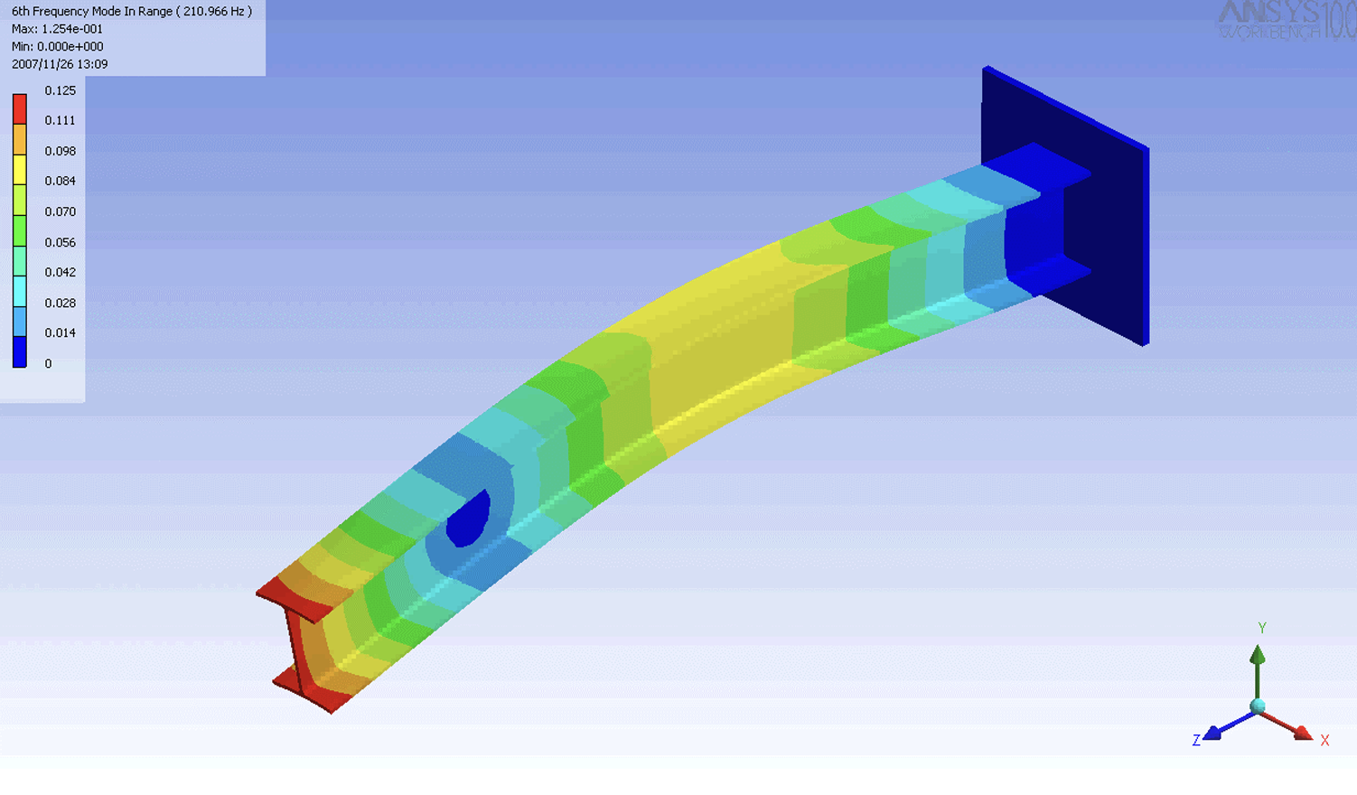
Basic of FEM with fin analysis -- (a)
What is Finite Element Method?
FEM is an analytic method to find solution by calculating mesh.
For example, it can be used analyzing critical stress or temperature of material, deflection of beam.

Slide 5
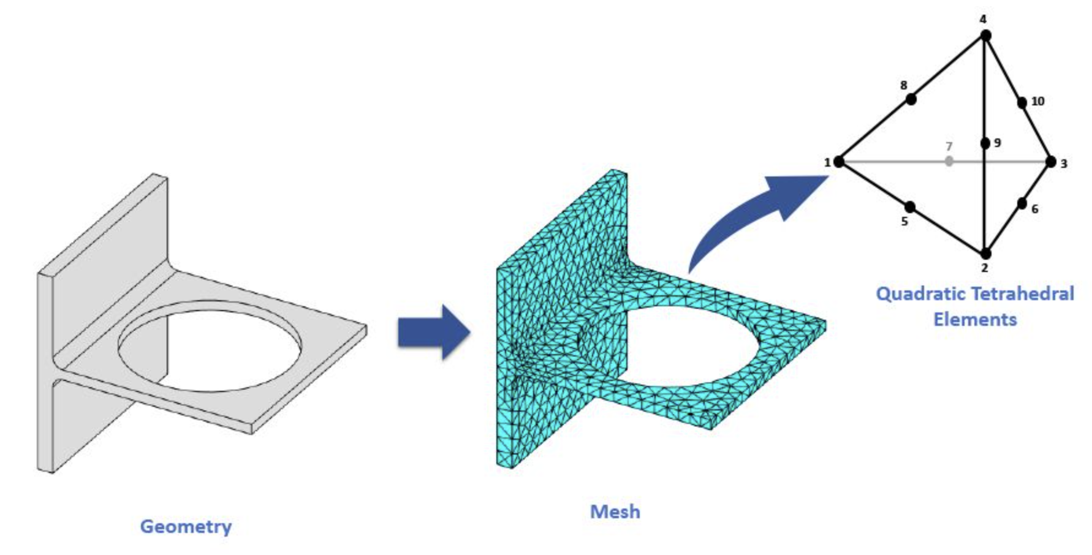
Basic of FEM with fin analysis -- (a)
What is Finite Element Method?
FEM is an analytic method to find solution by calculating mesh.
We slice given geometry to “element”.
We call the set of every elements, “mesh”.

Slide 6
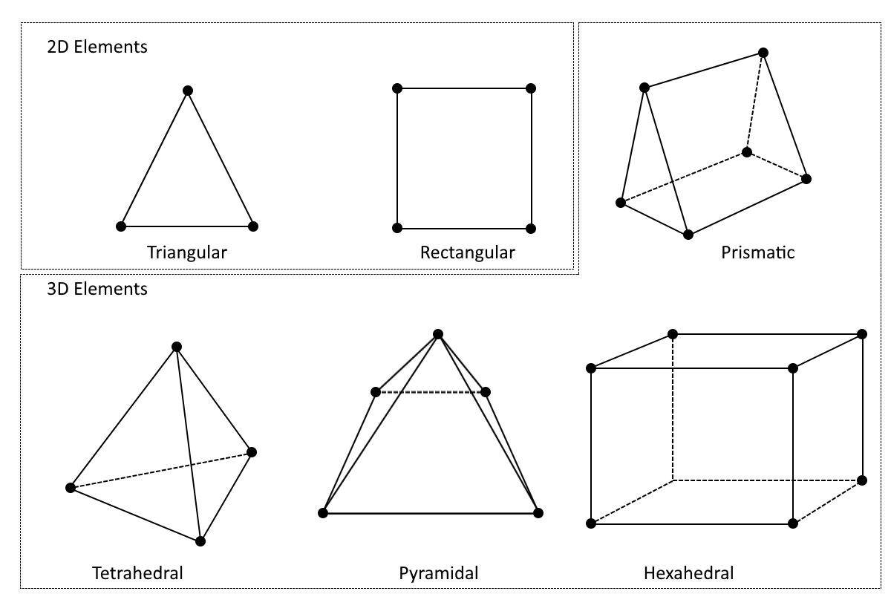
Basic of FEM with fin analysis -- (a)
What is Finite Element Method?
FEM is an analytic method to find solution by calculating mesh.
There could be multiple ways to generating mesh.
The geometry of mesh may affect the result.

Slide 7
Basic of FEM with fin analysis -- (a)
What is Finite Element Method?
FEM is an analytic method to find solution by calculating mesh.
node
We call every vertex of mesh “node”.
Eventually, FEM is a way that calculates every nodes via govern equation.

Slide 8
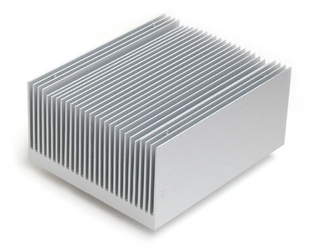
Basic of FEM with fin analysis -- (b)
What is fin?
Fin is a surface that extend from an hot object to increase the heat transfer rate.
The amount of conduction, convection and radiation will affect the heat transfer.
In short, if the fin can transfer heat faster, the CPU can cooler.

Slide 9
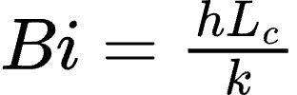
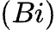
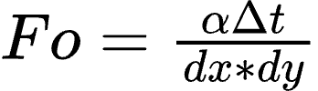
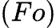
Basic of FEM with fin analysis -- (c)
How can we do this?
There are several important coefficient about transient fin heat transfer.
Biot number
Fourier number

Slide 10
Basic of FEM with fin analysis -- (c)
How can we do this?
Biot number
Biot number is a coefficient that shows contribution of convection versus conduction in transient heat transfer.
If Biot number >> 1, convection will be the dominant factor that contributes heat transfer
If Biot number << 1, conduction will be the dominant factor that contributes heat transfer

Slide 11
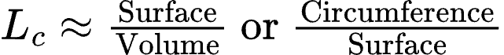
Basic of FEM with fin analysis -- (c)
How can we do this?
Biot number
characteristic length is approximated length that describes “outer region VS inner region”

Slide 12
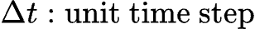
Basic of FEM with fin analysis -- (c)
How can we do this?
Fourier number
Fourier number is a coefficient that describes “how much heat will travel during the unit time step”.

Slide 13
Basic of FEM with fin analysis -- (c)
How can we do this?
Fourier number
Larger the unit time step becomes, unit mesh length has to be larger too.
If we set smaller unit mesh, FEM will collapse, since heat will pass through current mesh element and affect the others.

Slide 14
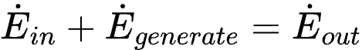
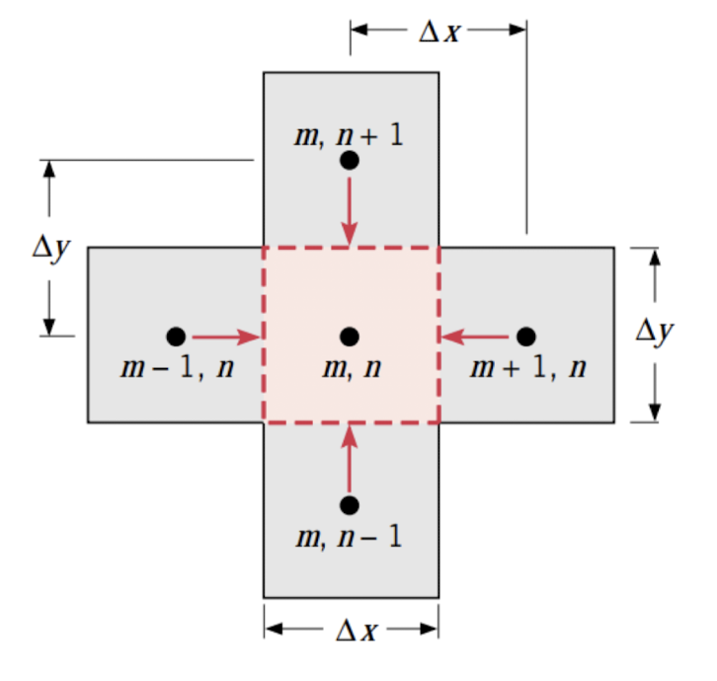
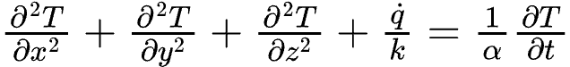
Basic of FEM with fin analysis -- (c)
How can we do this?
FEM is based on energy equilibrium.
(Heat flows to (m,n)) + (Heat that generated by (m,n))
= (Heat that (m,n) emit)
Assume there’s no heat generated by material, (q = 0)
and apply this condition to Heat diffusion equation
We can use finite difference approximation to calculate second derivative.

Slide 15
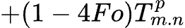
Basic of FEM with fin analysis -- (c)
How can we do this?
Eventually, we can describe the node like below
Note that in only applies 2-dimensional, closed mesh
(4 nodes are adjacent with node (m,n))

Slide 16
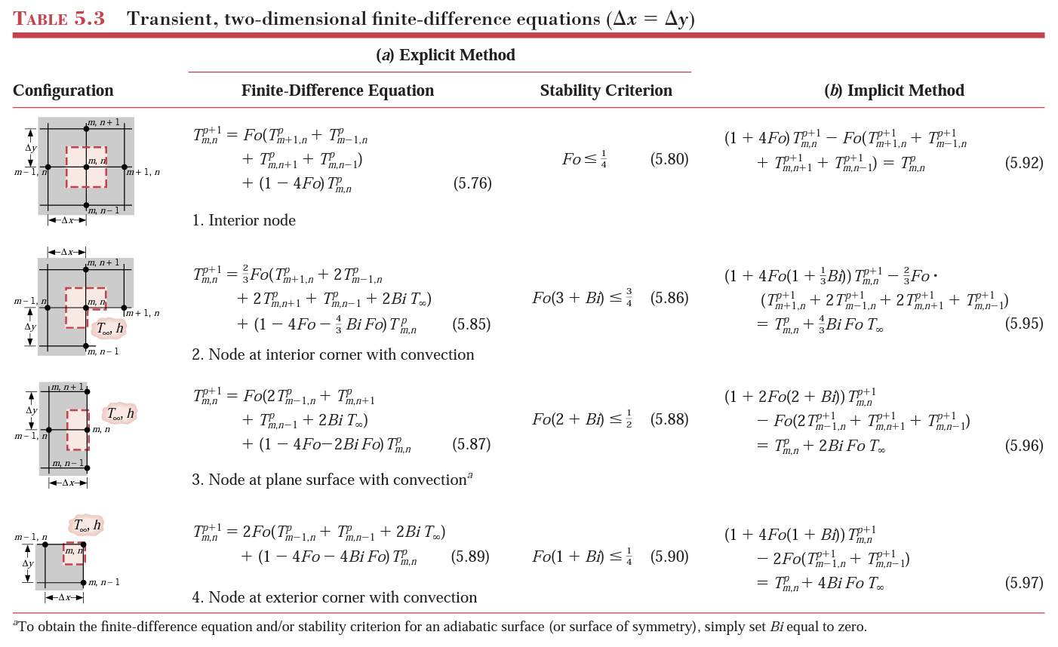
Basic of FEM with fin analysis -- (c)
Other mesh case can be calculated like this
Bergman, T. L., and Frank P. Incropera. Fundamentals of Heat and Mass Transfer. Seventh edition. Wiley, 2011, 330-334

Slide 17
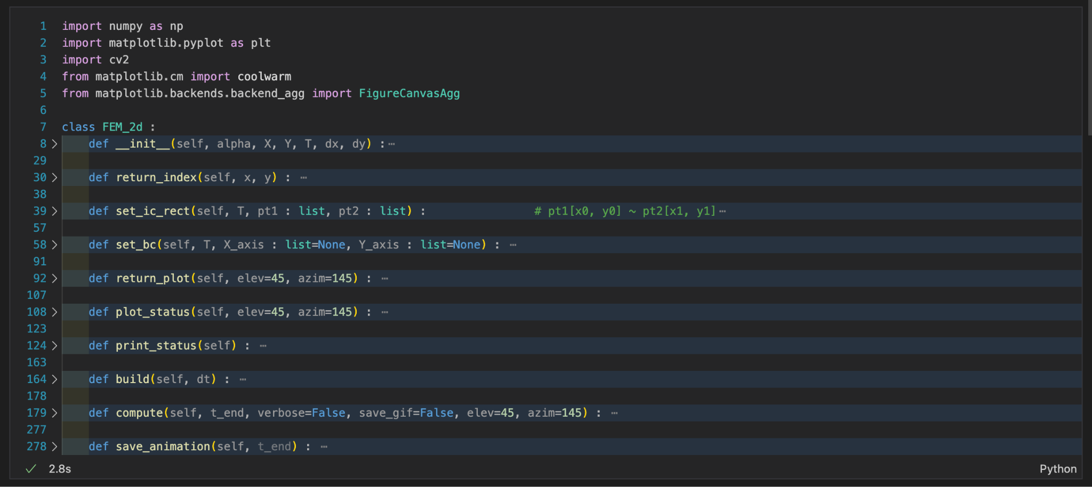
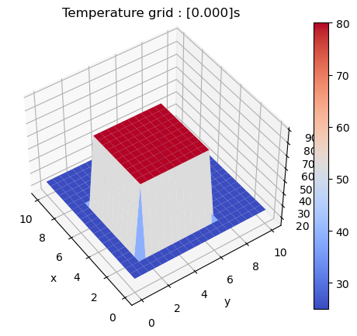
FEM with solid conduction heat transfer
We made first model using numpy, matplotlib, and OpenCV to export animation

Slide 18
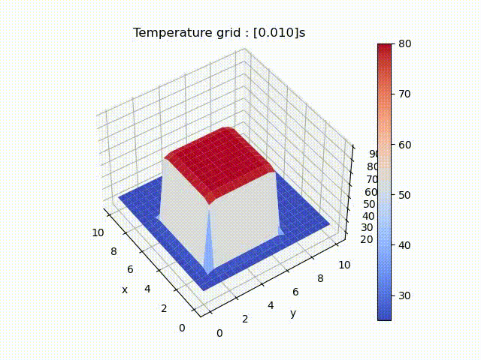
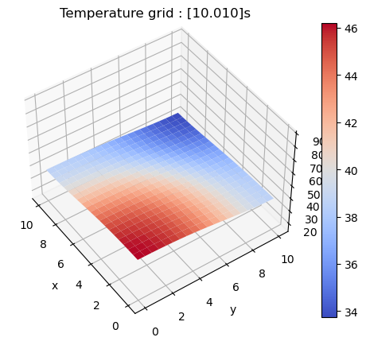
FEM with solid conduction heat transfer
It’s a model for rectangular fin, only affected by conduction and boundary condition.

Slide 19
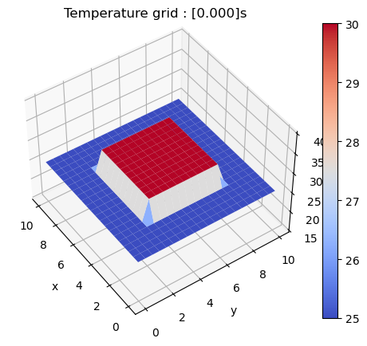
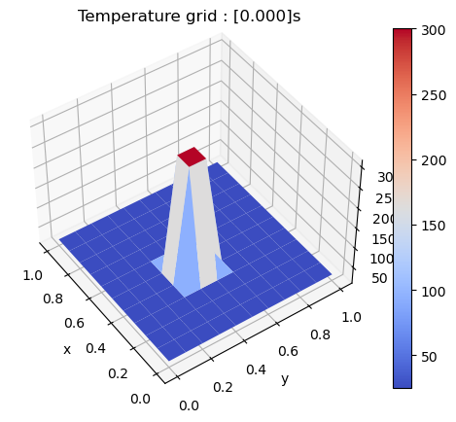
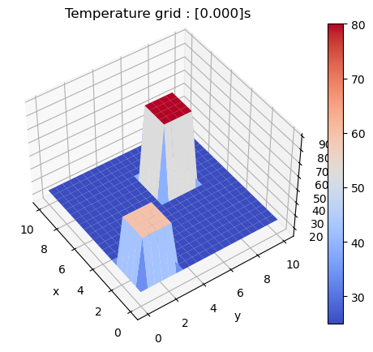
FEM with solid conduction heat transfer
You can adjust mesh size, initial conditions and boundary conditions

Slide 20
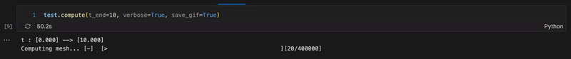
FEM with solid conduction heat transfer
There are disadvantage with this model
There’s too many meshes to calculate.
Using OpenCV to animate process wasn’t good idea.
There’s no utils for computing mesh until steady-state is reached.

Slide 21
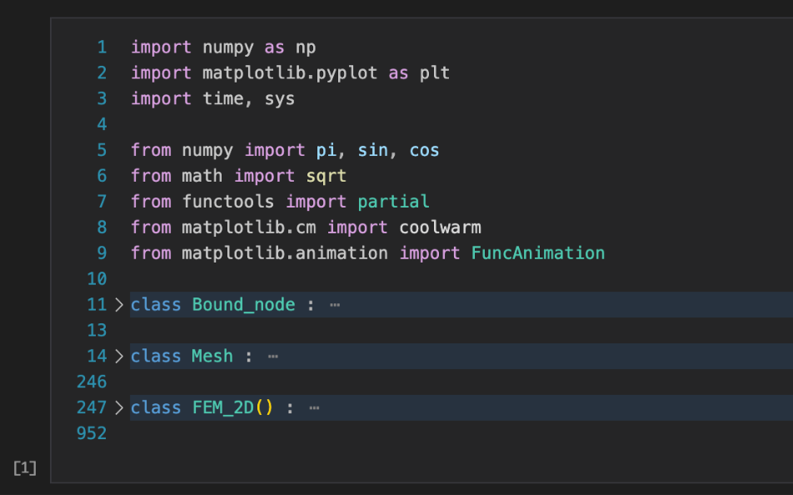
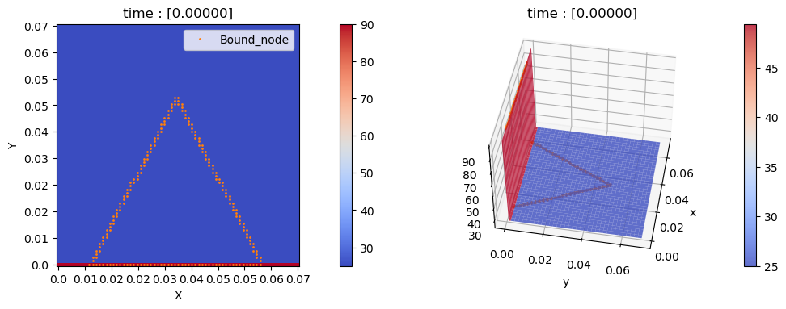
FEM with given fin mesh
We’ve made a second model that decrease computation, and uses FuncAnimation of matplotlib to animate process.
To decrease computation, we only compute the mesh inside the fin.
we only compute inside of the fin

Slide 22
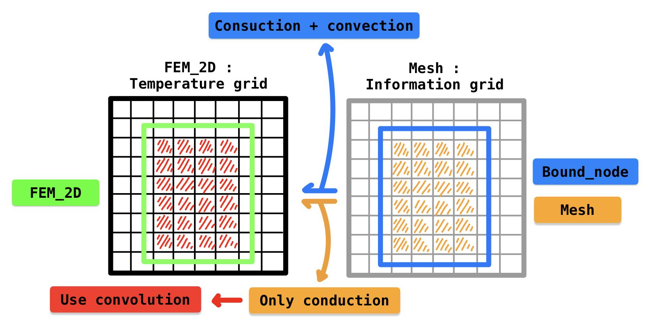
FEM with given fin mesh
We’ve made a second model that decrease computation, and uses FuncAnimation of matplotlib to animate process.
To decrease computation, we use convolution to compute inner temperature of fin.
Because inside the fin, every nodes have 4 adjacent nodes, which means only conduction occurs, makes computation easier.
Details at final report - [2. model idea]

Slide 23
FEM with given fin mesh
We’ve made a second model that decrease computation, and uses FuncAnimation of matplotlib to animate process.
To decrease computation, we use convolution to compute inner temperature of fin.
Because inside the fin, every nodes have 4 adjacent nodes, which means only conduction occurs, makes computation easier.
Details at final report - [2. model idea]

Slide 24
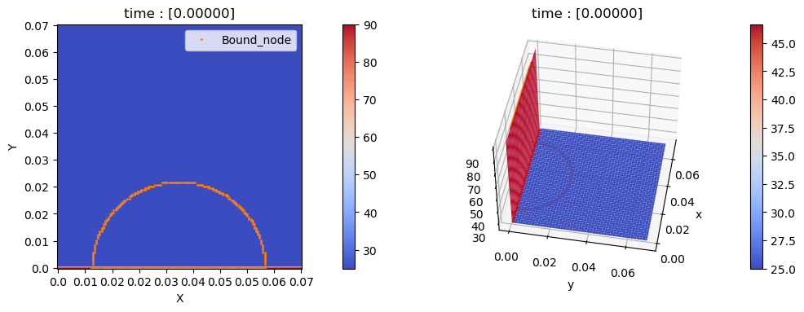


FEM with given fin mesh
There are three geometry of second model
Half-circle mesh
Rectangular mesh
Triangular mesh

Slide 25
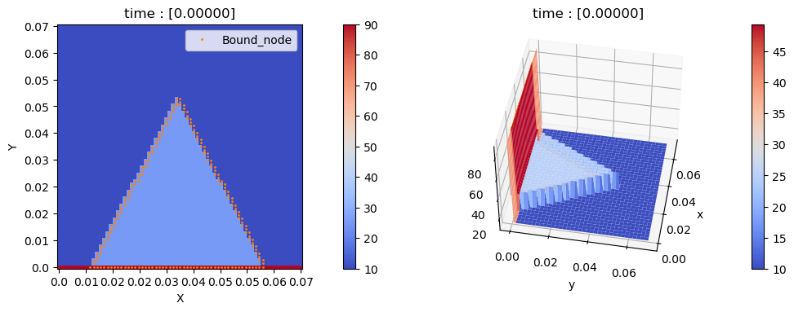
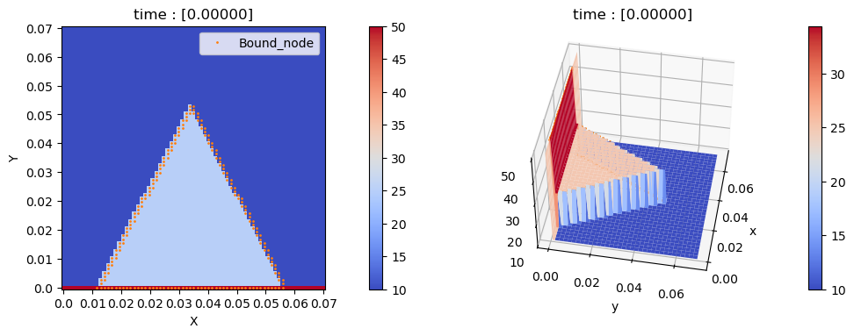
FEM with given fin mesh
Model can adjust boundary condition, initial condition, and mesh size.
This model includes the convection heat transfer via surrounding air with given coefficient and temperature
You can see both the air and boundary temperature are different

Slide 26
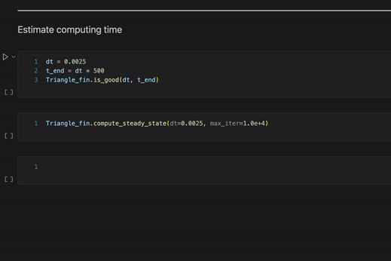
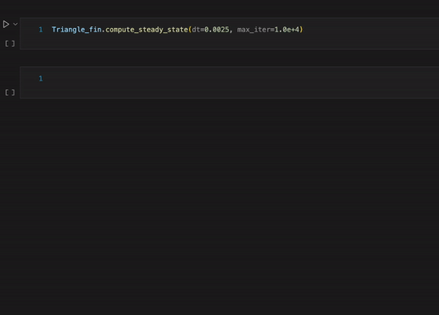
FEM with given fin mesh
We made a utils that compute mesh until steady-state.
If the model reaches steady-state in max iteration, it will shows the precision of convergence and average temperature. Otherwise, it will stop

Slide 27
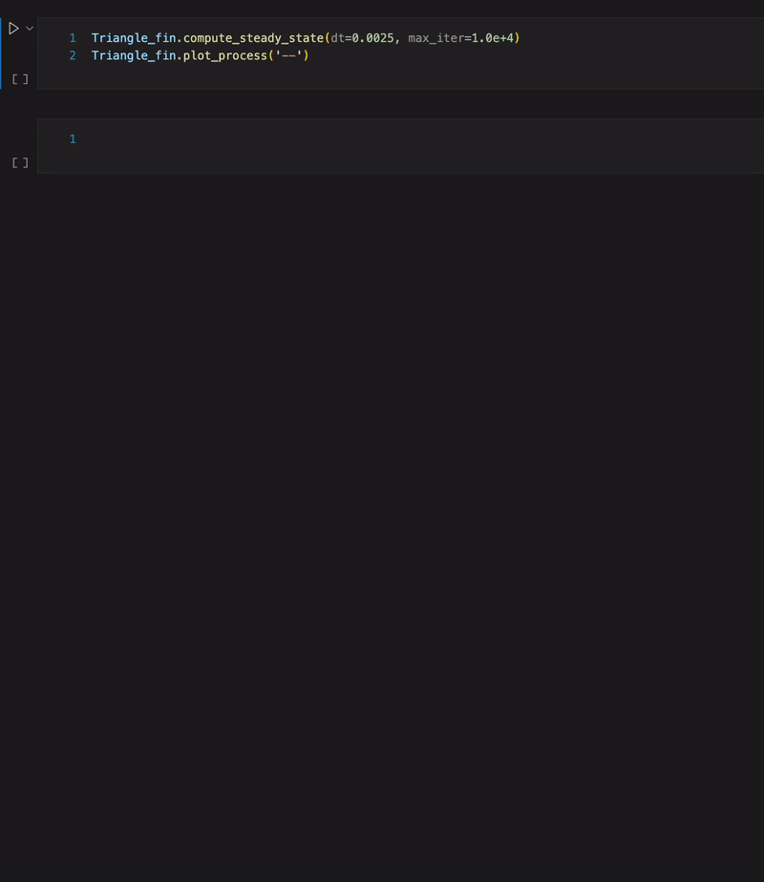
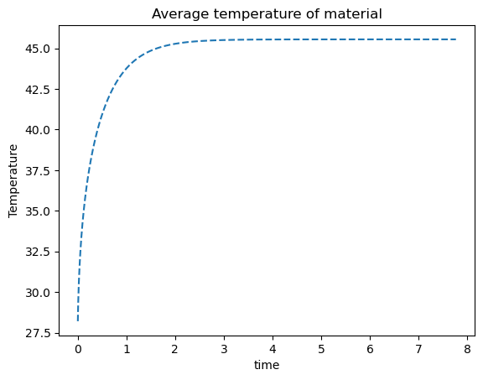
FEM with given fin mesh
You can watch the average temperature difference via time.
And you can save or import computing result.

Slide 28
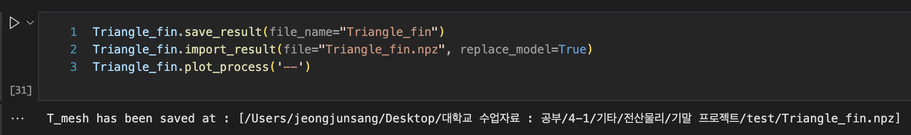
FEM with given fin mesh
You can watch the average temperature difference via time.
And you can save or import computing result.

Slide 29
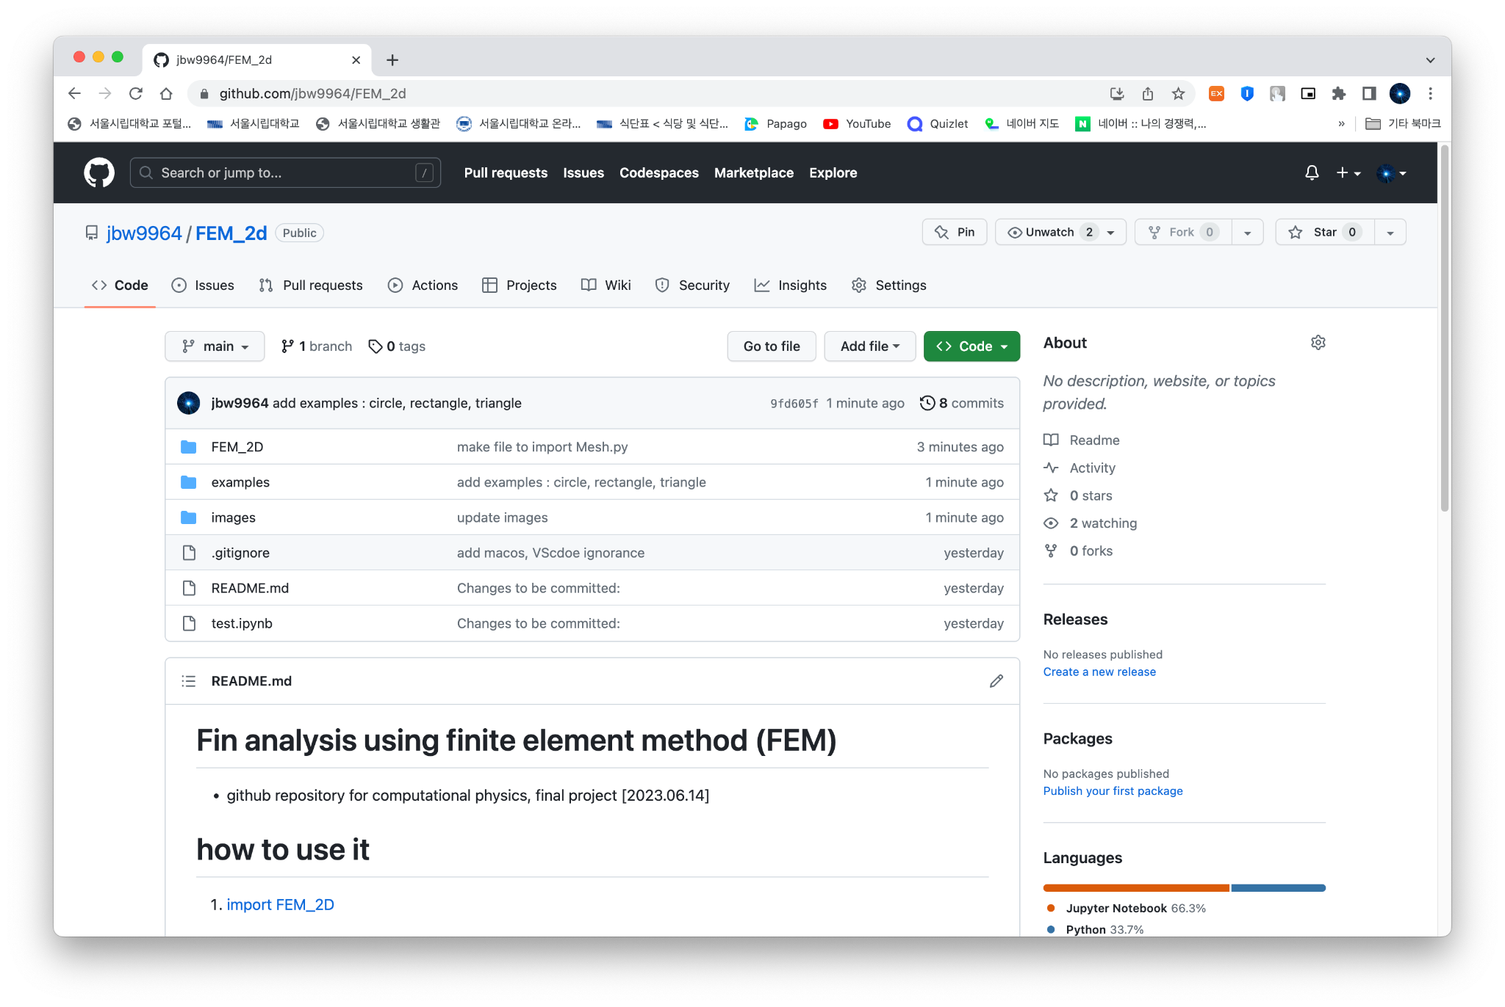
FEM with given fin mesh
More details at github repository.
https://github.com/jbw9964/FEM_2d.git

Slide 30
4. Result 2D & 3D
Shapes?

Slide 31
4-1. 2D results

Slide 34
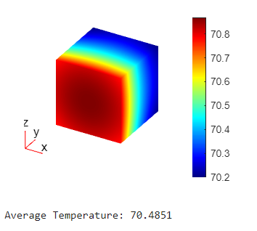
4-2. 3D results
steady state
transient video

Slide 35
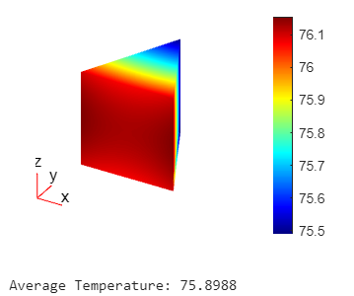
steady state
transient video

Slide 36
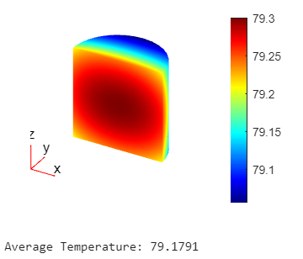
steady state
transient video

Slide 37
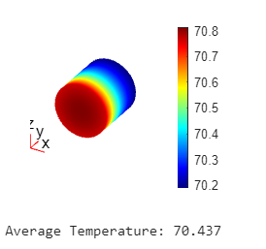
steady state
transient video

Slide 38
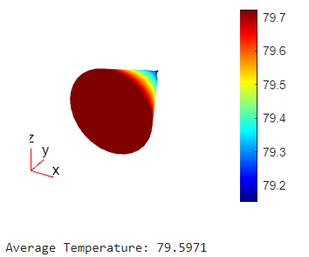
steady state
transient video

Slide 39
transient video

Slide 41
5. Analysis
heat sink재료: 알루미늄 합금.. 접촉부분 Cu, 나머지(fin부분 등) Al사용 경우 多

Slide 42
